Slide 1
Use of IT in Anti-Fraud Efforts & Empanelment for Bihar (Work flow diagram & Implementation)
AB-PMJAY (Bihar) in collaboration with ADRI
Presented by: Dr Mousumi Gupta
[Materials taken from Microsoft Word - Anti-fraud PMJAY Guidelines- Released-Aug 27 .docx (ayushmanup.in)]

Slide 2
Fraud type
Beneficiary fraud (Main focus):
Fraud conducted by an eligible beneficiary of PMJAY
Payer fraud:
Fraud conducted by a staff or consultant of NHA or SHA or personnel employed by any of the agencies contracted by the NHA or the SHA directly or indirectly
Provider fraud
Fraud conducted by any private or public health service provider empaneled for providing services under PMJAY
[For further reading (Annex 1: Page 21)] (We are not concentrating on)

Slide 3
NHA responsibilities
NHA
Develop anti-fraud framework, guidelines and policies
Provide broad oversight
Design IT infrastructure and protocols for advanced data analytics for fraud detection
Provide technical assistance to states
There are dedicated anti-fraud cell for each state (NE (1 officer) , Non-NE/HFS (2 officer) , Non-HFS (2 officer), Non-HFS (1 officer) by NHA . [More read: Page 10]

Slide 4
SHA responsibilities
SHA
Develop institutional structures
Adapt and approve state anti-fraud policies and guidelines
Develop IT system
Conduct anti-fraud awareness
Develop and implement mechanisms for preventing and detecting all kinds of fraud under PMJAY
Data analytics
Contract design, management and enforcement
Data architect by ADRI

Slide 5
Use of IT in Anti-Fraud Efforts (Joint venture with ADRI team)
IT infrastructure for detecting fraud
Fraud triggers
Data mining and analytics
Automated tools to assist in fraud management
[Development on Day-to-day overall report through dashboard]

Slide 6
In the area “Data mining and analytics” (Main focus)
In prospective analysis: to analyze current data through dashboard to determine the legitimacy of claims
In retrospective analysis: to identify patterns of fraudulent behavior based on historical information

Slide 7
Initial plan for designing dashboard on AB-PMJAY Bihar fraud detection (From ADRI) based on four options
Patient Admitted in Watchlist Hospitals
High value claims
Hospital Bed Cases
Family ID Cases
Geographic Anomalies
Opthalmology (Cataract)

Slide 8
District wise flagged cases
Patient Admitted in Watchlist Hospitals
Flagging the cases from suspicious hospital list
Overall analysis
Identify the cases who claimed larger than 1 Lakh in Surgery Department
High value claims
Identify the cases who claimed larger than 25,000 in Medical Department
Case-wise analysis

Slide 9
Mapping with number of daily admissions of the hospital and the bed strength of the hospital.
If (Number of admissions > bed strength) then mark.
Hospital bed
Part A
No more than 30 cases per OT per Surgeon
Ophthalmology (Cataract)
Part B
Pre-auth time between 8 AM to 6 PM
Part C
The patient’s age should be less than 40 years
Emergency
Emergency in cataract, Oncology, Dialysis
Multiple usage of ID
Same day, same family ID with more than 2 cases
Case-wise analysis

Slide 10
Geographic anomalies
Mapping between patient’s state with treatment in different geographic location
Case-wise analysis

Slide 11
Implementation of Fraud detection dashboard
Utilized Django management commands for automated data import
Core business logic implemented in Python using Django views and Pandas
Use of Django’s ORM to filter and count records for different time ranges (Overall, Last 30 Days, Yesterday)
Input data:
Excel files (Last 24 Hours, Suspicious Hospital List, Hospital Beds)were taken using Pandas
Data normalization: stripping extra spaces, case normalization (uppercasing IDs)

Slide 12
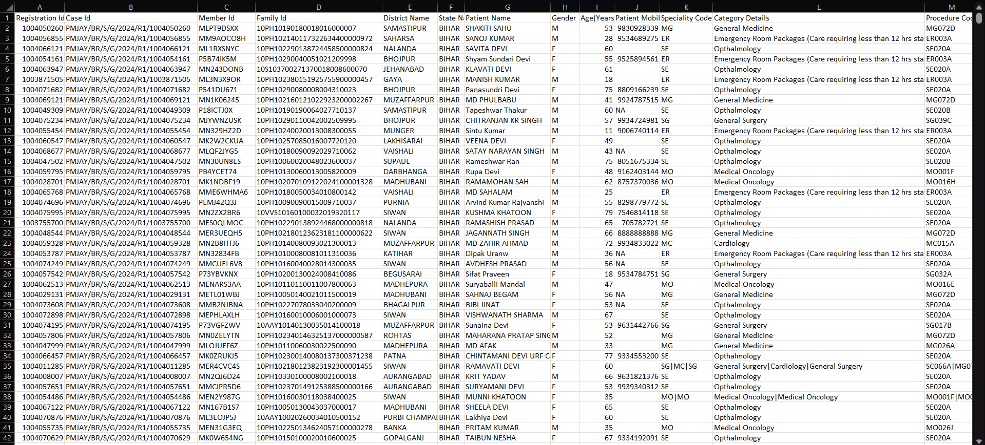
Input data (snapshot)
Fig 1: Snapshot of data of patients on a particular day

Slide 13
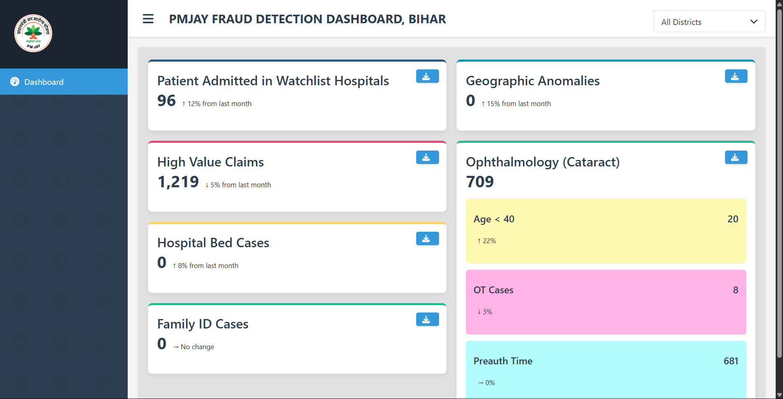
Snapshot for dynamic dashboard created till date
Reflected cases can be downloaded
Fig2: Snapshot of dashboard displaying the necessary data

Slide 14
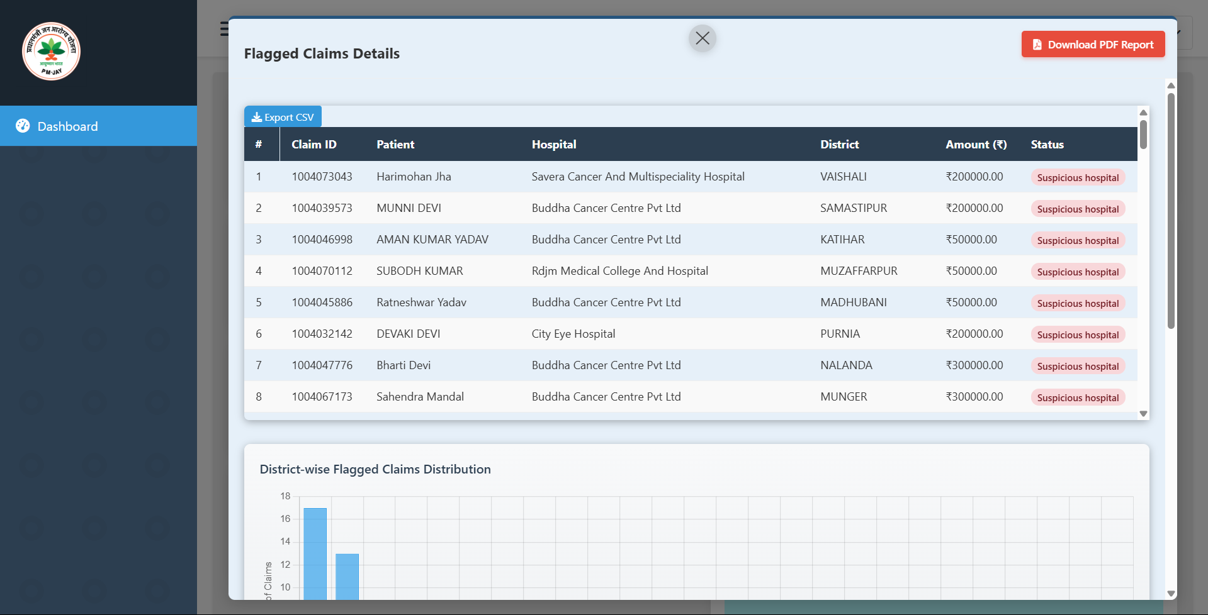
Snapshot for dynamic dashboard created till date
Case Wise Visualization Page
Fig3: Snapshot of case-wise visualizations page

Slide 15
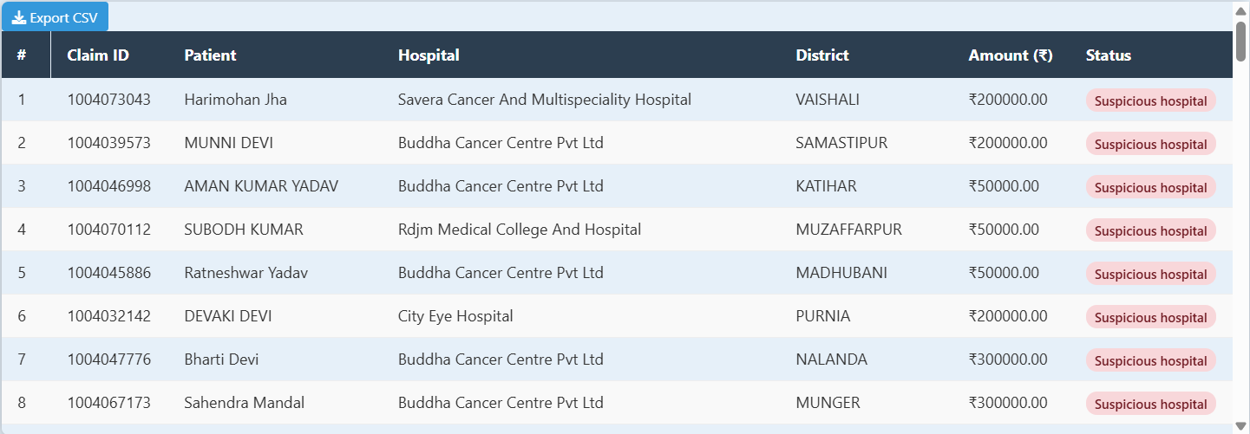
Snapshot for dynamic dashboard created till date
All flagged patient details
Fig4: Snapshot of table visualization

Slide 16
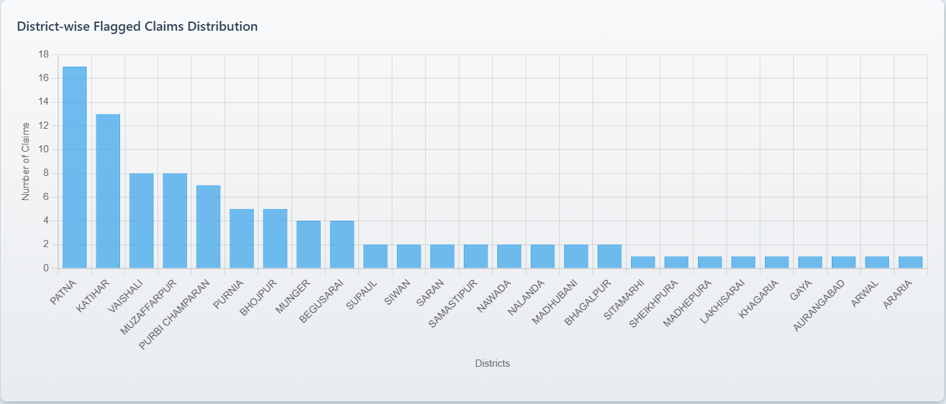
Snapshot for dynamic dashboard created till date
Bar Chart representation (District-Wise)
Fig 5: Snapshot of bar-chart visualization

Slide 17
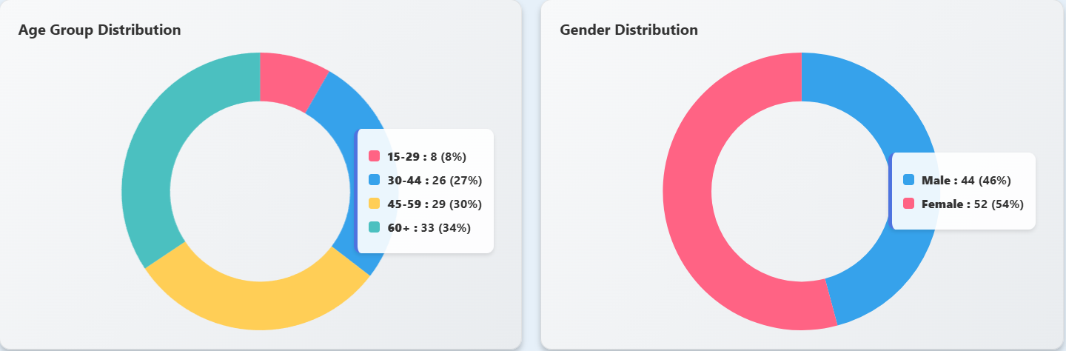
Snapshot for dynamic dashboard created till date
Pie-Chart representation (Age Groups and Gender Distribution) (District-Wise)
Fig 6: Snapshot of dashboard displaying the pie-chart representation of two aspects: “Age-Groups” and “Gender Distribution” and district-wise

Slide 18
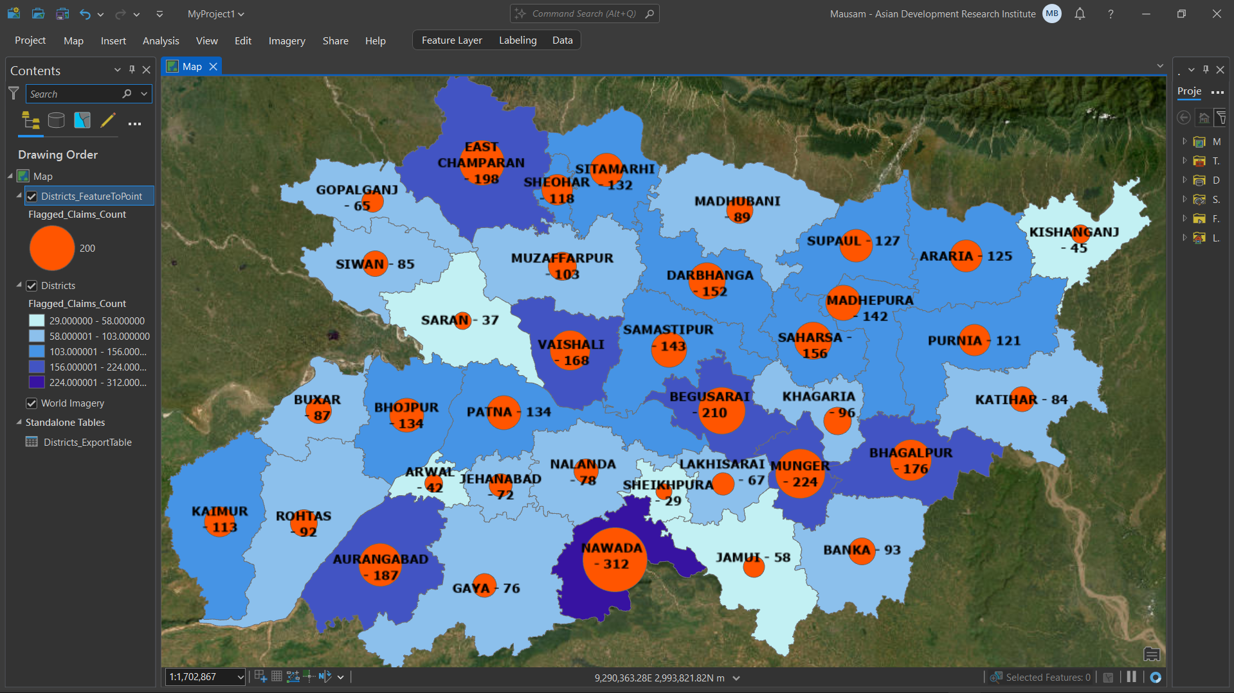
Snapshot for dynamic dashboard created till date
Heat-Map representation
Fig 7: Snapshot of development of the heat-map representation district-wise

Slide 19
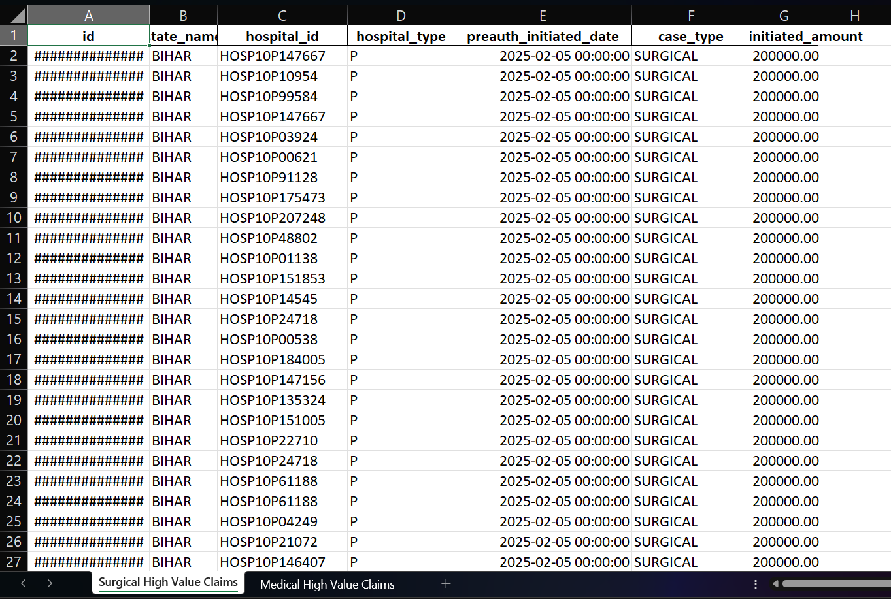
Downloaded data (snapshot)
Fig8: Snapshot of downloaded data of “High Value Claims” having two separate sheets: “Surgical” and “Medical”

Slide 20
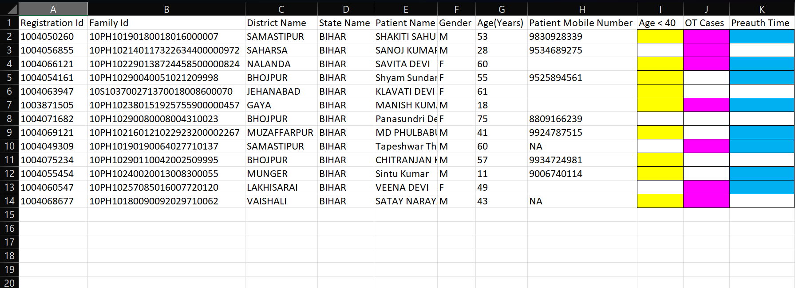
Downloaded data (snapshot)
Fig8: Sample snapshot of downloadable data of “Ophthalmology (Cataract)” having color coded results for Age less than 40(Yellow), OT Cases(Magenta), and Pre-auth Time(Cyan)

Slide 21
PM-JAY “Empanelment”
SHA role on Empanelment
Awareness among the healthcare service providers
Verification & Approval
ADRI working as a collaborative partner
Healthcare Service Provider Landscape
Done by SHA

Slide 22
Workflow for Dashboard on Hospital Empanelment
Categorize log in facility
CEO (Read/edit)
Medical Doctor (Read)
District level officer (Read)
Total number of hospital available district wise
Categorization among the hospitals
Speciality wise
Total number of specialist doctor available
Bed strength wise
Mandatory documents verification information
Clinical Registration
Fire NOC
Bio-Medical authorization
Pop-up will appear on the lapse of expiry date for the mandatory documents

